Slide 1
CSE 4255 Cellular Network
Lecture 8
Improving Coverage and Capacity

Slide 2
Capacity Problem?
As the demand for wireless service increases, the number of channels assigned to a cell eventually becomes insufficient to support the required number of users which leads Capacity Problem.
We can improve capacity by
Adding New Channel
Reduce the cluster size
Therefore, new cellular design techniques are needed to provide more channels per unit coverage area.

Slide 3
Techniques to Improve Capacity:
Cell Splitting
Cell Sectoring
Microcell Zone Concept

Slide 4
1. Cell Splitting :
It is the process of subdividing the congested cell into smaller cells with
their own base station
a reduction in antenna height and transmitted power.
Splitting the cell reduces the cell size thus more number of cells have to be used.
Cell Splitting allows the system to grow by replacing large cells with smaller cells without changing the co-channel re-use ratio Q.
Notes:
We know that if we increase the number of cluster within limited area then we can use the same frequency more times. That is the concept of cell splitting.
**More number of cells implies more number of clusters, more number of clusters implies more number of channels
**The distance between co-channel cells also reduces to half (D=D/2) as the cell radius is reduced to half (R=R/2).
Thus the co-channel reuse ratio(Q=D/R) remains same.

Slide 5
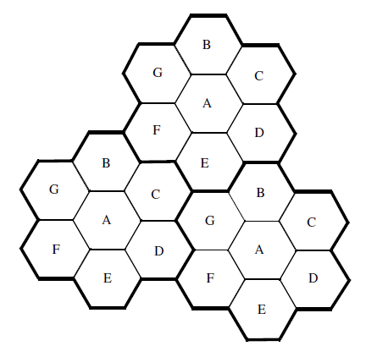
Process of Cell Splitting
Base stations are placed at the corners of the cells
The area served by base station A is assumed to be saturated with traffic.
Cell Splitting is applied, the original base station A has been surrounded by six new microcell base stations.
The radius of each new microcell is half that of the original cell.
Microcell G was placed half way between two larger stations utilizing the same channel set G.
Figure 1: Cell Splitting
Notes:
Assume that area served by BS A is saturated with traffic.
New BSs are needed to increase the no. of channels in the area and to reduce the area served by single BS.
BS A has been surrounded by 6 new μcells.

Slide 6
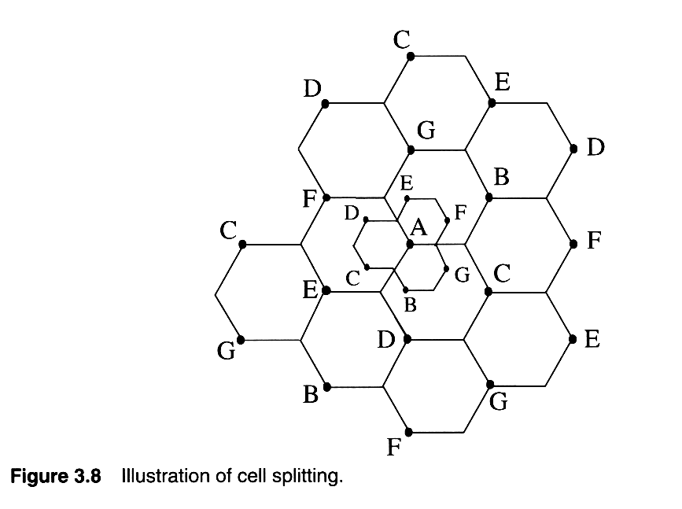
Process of Cell Splitting
Base stations are placed at the corners of the cells
The area served by base station A is assumed to be saturated with traffic.
Cell Splitting is applied, the original base station A has been surrounded by six new microcell base stations.
The radius of each new microcell is half that of the original cell.
Microcell G was placed half way between two larger stations utilizing the same channel set G.
Figure 1: Cell Splitting
Notes:
Assume that area served by BS A is saturated with traffic.
New BSs are needed to increase the no. of channels in the area and to reduce the area served by single BS.
BS A has been surrounded by 6 new μcells.

Slide 7
Cell Splitting
By decreasing the cell radius R, and keeping the co-channel reuse ratio D/R unchanged, cell splitting increases the number of channels per unit area.
The distance between co-channel cells also reduces to half (D=D/2) as the cell radius is reduced to half (R=R/2). Thus the co-channel reuse ratio(Q=D/R) remains same.
D/2
D
Figure 2: Cell Splitting

Slide 8
How much the transmit power must be reduced for the new smaller cells?
The receiving power at the new and old cell boundary
Pr [received power at old cell boundary] ∞ P_{t1} R^{-n}
Pr [received at new cell boundary] ∞ P_{t2} (R/2)^{-n}
P_{t2} = P_{t1}(1/2)^{n}
where P_{t1} and P_{t2}, are the transmit powers of the larger and smaller cell base stations, respectively, and n is the path loss exponent.
Notes:
** Find the received power (Pr) at the new and old cell boundaries and setting them equal to each other.
** If we take n = 4 and set the received power equal to each other, then
P_{t2} = P_{t1}/16;
The transmit power must be reduced by 12 dB in order to fill in the original coverage area.

Slide 9
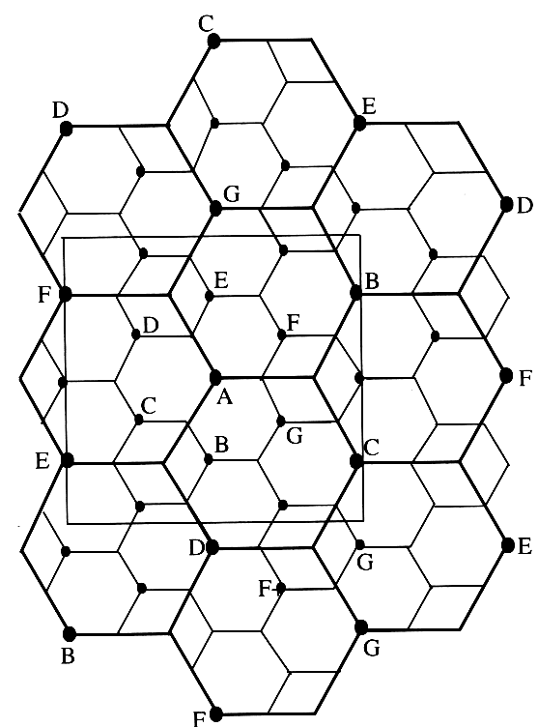
Example-1
Consider Figure; Assume each base station uses 60 channels, regardless of cell size. If each original cell has a radius of 1 Km and each microcell has a radius of 0.5 Km, find the number of channels contained in a 3 Km by 3 Km square centered around A under the following conditions:
without the use of microcells;
when the lettered microcells as shown in Figure 3 are used, also calculate increase in capacity; and
if all the original base stations are replaced by microcells. Assume cells on the edge of the square to be contained within the square.
Figure 3: Figure for Example

Slide 10
Solution
(a) 5x60 = 300 channels
(b) 5+6 = 11
11 x 60 = 660 channels
(c) 5 + 12 = 17 channels
17 x 60 = 1020 channels

Slide 11
Cell Splitting: Problems
Cell splitting increases the number of base stations in order to increase capacity.
Decreasing the cell radius in different size may increase CCI.
Handoff issues must be addressed so that high speed and low speed traffic can be simultaneously accommodated (the umbrella cell approach is commonly used).
Notes:
=> By decreasing the cell radius R and keeping the co-channel reuse ratio D/R
unchanged, cell splitting increases the number of channels per unit area.
Increases SIR will decrease CCI and reduce cluster size will improve capacity.
If we decrease D/R, then CCI will increase. But sectoring doing opposite. How? See ans in dr. ranjan lec7.pdf

Slide 12
2. Cell Sectoring
The technique for decreasing co-channel interference and for increasing system performance by using directional antennas is called sectoring.
As opposed to cell splitting, where D/R ratio is kept constant while decreasing R, sectoring keeps the R untouched and reduces the D/R.
Capacity improvement is achieved by reducing the number of cells per cluster, thus increasing frequency reuse.
Notes:
=> By decreasing the cell radius R and keeping the co-channel reuse ratio D/R
unchanged, cell splitting increases the number of channels per unit area.
Increases SIR will decrease CCI and reduce cluster size will improve capacity.
If we decrease D/R, then CCI will increase. But sectoring doing opposite. How? See ans in dr. ranjan lec7.pdf

Slide 13
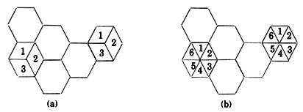
Process of Cell Sectoring
In Sectoring, cells are divided into a number of wedge-shaped sectors--typically three or six sectors per cell.
Replacing a single omnidirectional antenna at the base station by several directional antennas.
Directional antennas are used at the base station to focus on each sector.
Each sector is assigned a separate subset of the cell’s channels
A cell is normally partitioned into three 120° sectors or six 60°
Figure : Cell Sectoring (a)120 degree (b) 60 degree

Slide 14
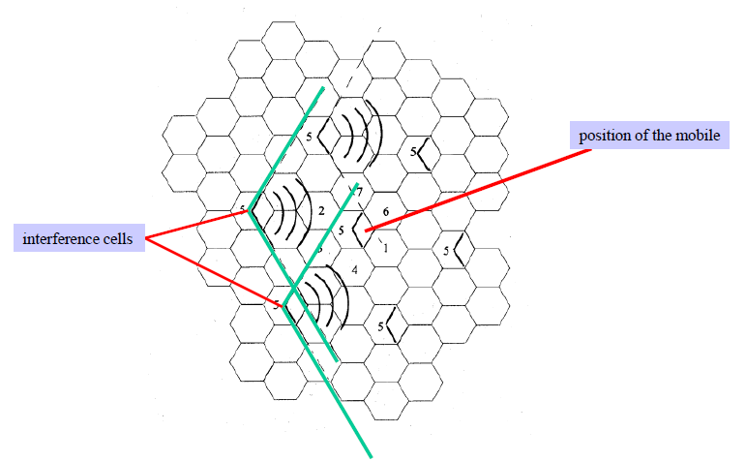
Cell Sectoring: Reduce CCI and Increase SIR
Figure 5: Improving SIR
Notes:
Without Sectoring: N = 7 and n= 4, SIR = sqrt(3N)⁴/i = sqrt(3x7)⁴/6 = 18.66dB
With 120 Sectoring: N = 7 and n = 4, SIR = 24.2 dB. If we need 18 db then we can reduce N. Reducing N will increase capacity.

Slide 15
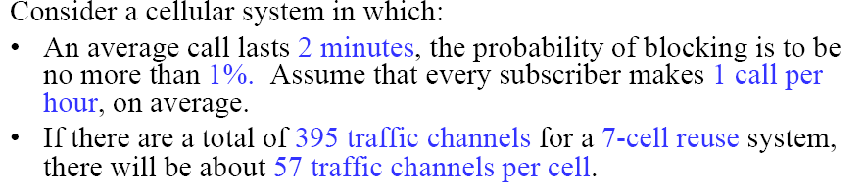
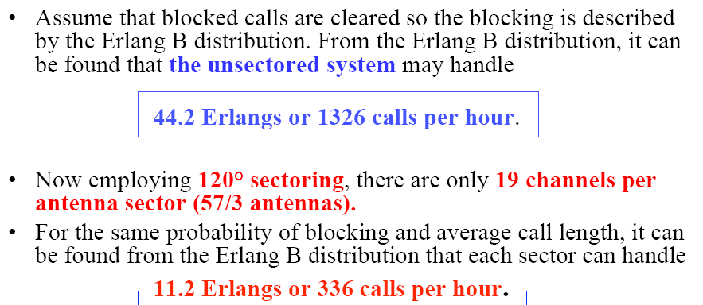
Cell Sectoring: Decrease Trunking Efficiency

Slide 16
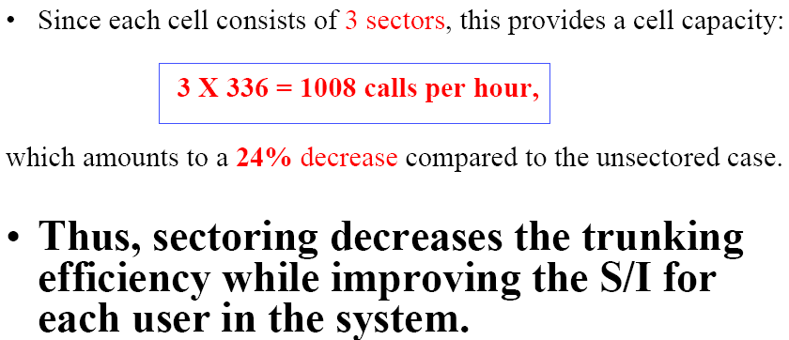

Slide 17
Cell Sectoring: Disadvantages
Increased number of antennas at each base station
Decrease in trunking efficiency due to channel sectoring at each base station
As sectoring reduces the coverage area of a particular group of channels, the number of handoffs increase.

Slide 18
Microcell Zone Concept
The Problems of sectoring can be addressed by Microcell Zone Concept
A cell is conceptually divided into microcells or zones
Each microcell (zone) uses a directional antenna. Antennas are placed at the outer edges of the cell and radiates power into the cell.
Each zone is connected to the same base station(fiber/microwave link).
Any channel may be assigned to any zone by the base station and MS is served by strongest zone.
As mobile travels from one zone to another, it retains the same channel, i.e no hand off.
The BS simply switches the channel to the next zone site.
Notes:
Cell is divided = that is conceptually not practically. Practically is 3 cell make a group.

Slide 19
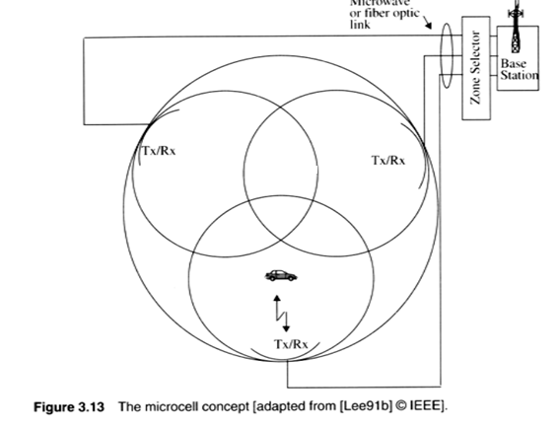
Microcell Zone Concepts

Slide 20
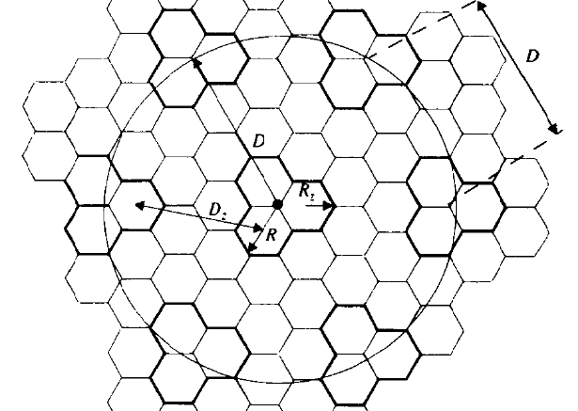
Advantage of Microcell Zone Concept
Co-channel interference is reduces since a large central base station is replaced by several lower powered transmitter on the edges of the cell.
Decrease of co-channel ratio, increase SIR which in turn decrease the cluster size N hence increase the capacity.
Notes:
For single zone,
N = 7, Dz/Rz = Q = sqrt(3N) = 4.6, SIR = Q^4/i = 4.6 ^4/6 = 18.66 dB
For 3 zone form a group or cell,
From figure we can identify N = 3, D/R = Q = 3, SIR = Q^4/i=1; SIR = 20dB
Here, I = 1 coz directional antenna and radiates in to cell makes only one co cell interference.

Slide 21
Problem 1
A cellular service provider decides to use a digital TDMA scheme which can tolerate a signal to interference ration 15 dB in the worst case. Find the optimal value of N for
Omni directional antenna
120 degree sectoring and
60 degree sectoring.
Should sectoring be used?
If so, which case (120 degree or 60 degree) should be used? (Assuming a path loss factor n = 4 and consider trunking efficiency.)

